Slide 1

RJM Algo Trading
Applying supervised learning machine models for classification and regression analysis to Bitcoin price data, with the objective of predicting when to buy or sell.

Slide 2
What Is A SVM Model.
Support Vector Machine (SVM) is a supervised machine learning algorithm primary used for classification tasks
Can we better predict trade type by projecting the Bitcoin dataset into a higher dimensional space using a SVM model?

Slide 3
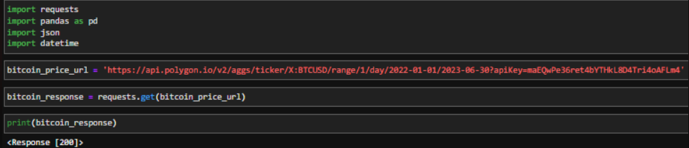
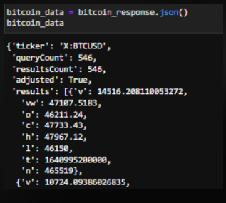
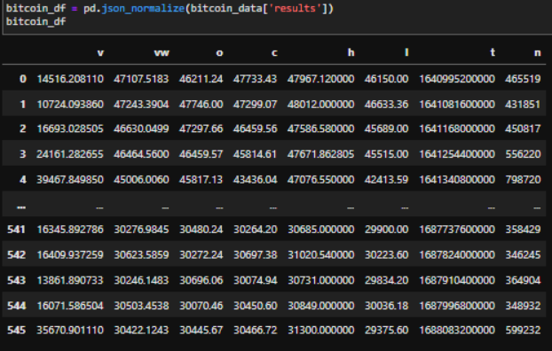
Source: Poligon.io API was selected because it was cost effective, highly available, intuitive and easy to use.
Using the API to retrieve Bitcoin price data
Problem: data output in JSON
_________________
Solution: Utilize PD.JSON_normalize to convert to a DataFrame

Slide 4
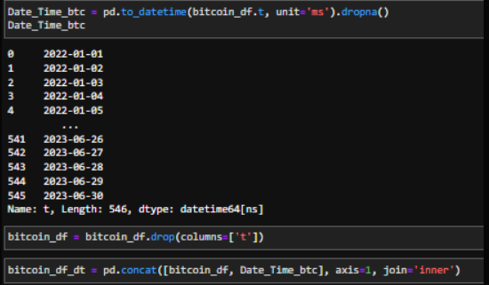
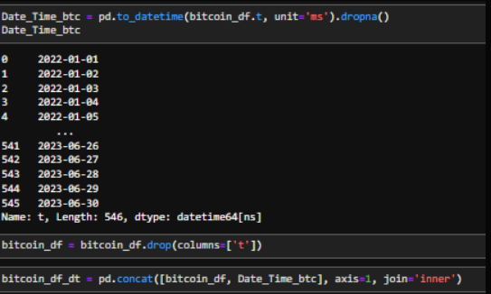
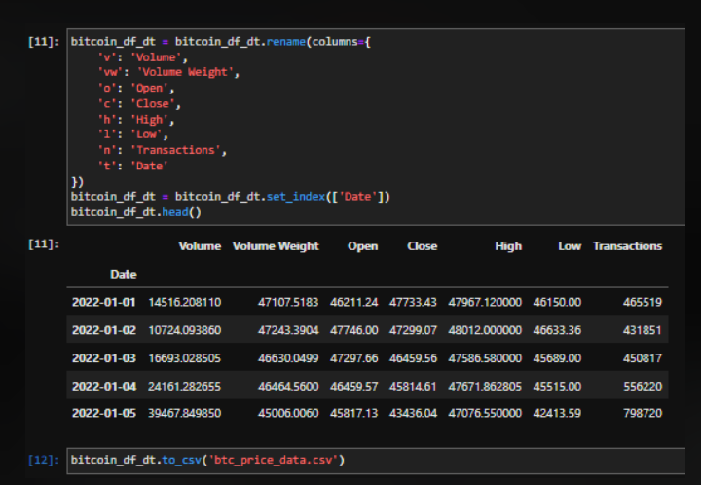
Problem: Output time was in Unix timestamp in milliseconds
__________________________
Solution: Convert to DateTime format using pd.to_datetime

Slide 5
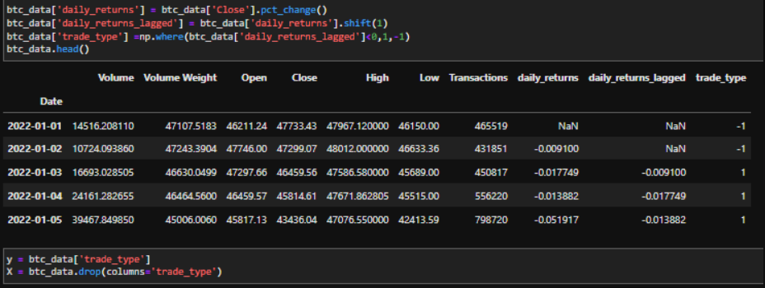
Introduced algorithmic trading data
_________________________
Added additional columns to classify trade type
Problem: Training the X data (train and test), produced Null values
_________________________________________________________________
Solution: This prompted the application of the simple imputer from sklearn.impute to replace the Null values using Mean Strategy

Slide 6
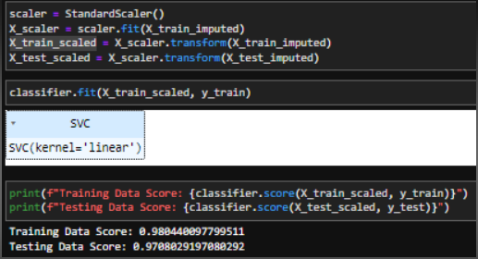
Training the SVM Model.
Initial attempts to fit the model, were unsuccessful. After scaling the data using auto-scaler, subsequent attempts to fit the model were fruitful.

Slide 7
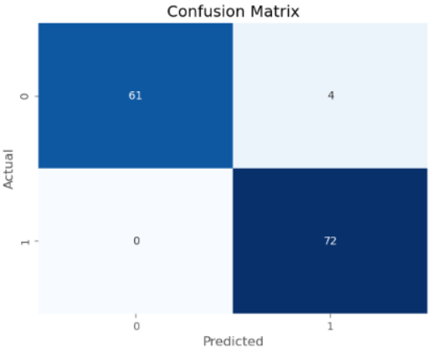
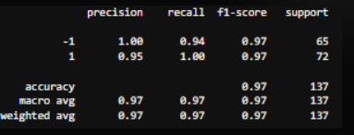
Confusion Matrix visualization illustrating the performance of the SVM model showing the predictive accuracy. This breaks down the predictions into four categories based on the actual and predicted class labels

Slide 8
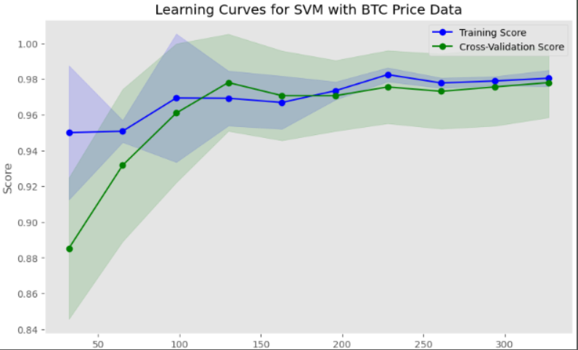
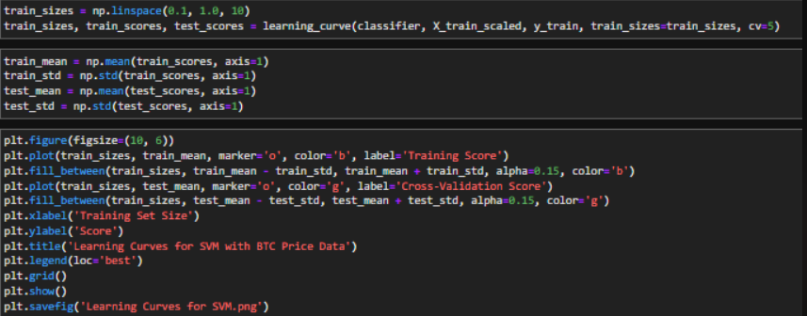
The visualization of the learning curves suggest that the complexity of the model has been optimized. Indicated by the training and validation curves converging with low error.

Slide 9
Next Steps….
This model appears to show that it can successfully predict Bitcoin trade types. Next steps could be to expand the dataset to other crypto currencies

Slide 10
Our Questions?
How would the model perform if we had more time to explore additional variables and additional models?
Your Questions….

